Slide 1
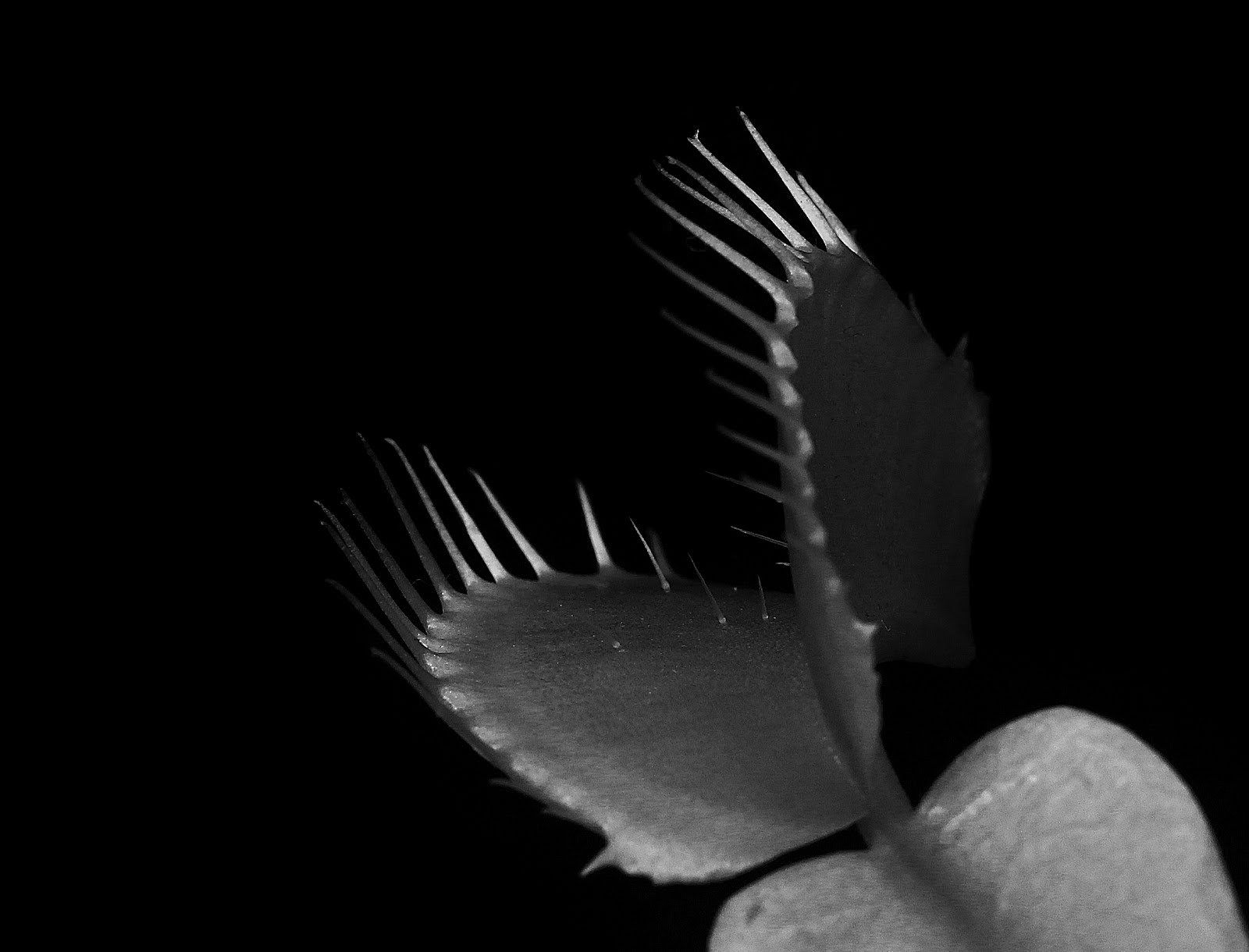


LIGHT

Slide 2

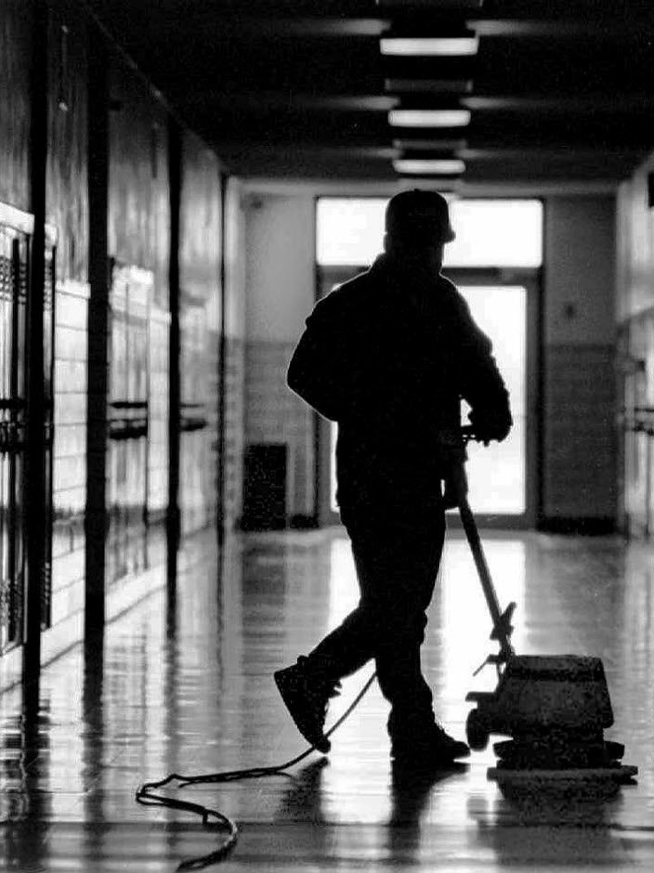

IMPOSSIBLE GIRL
THE SWEEPER

Slide 3
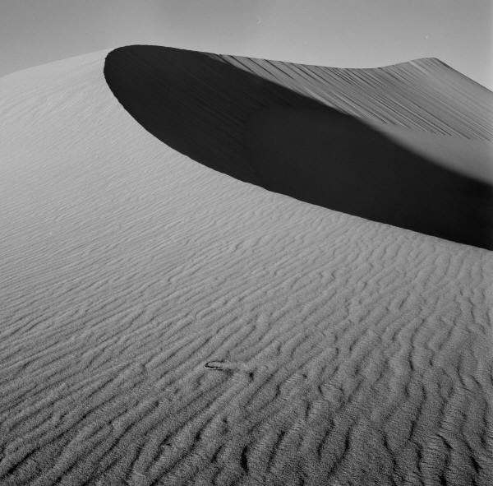
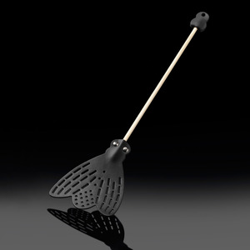
I: INITIAL INSIGHT & INTUITION
II: STRATEGIES & CONCEPTS
III: IMPLEMENTATION
IV: CHALLENGES
V: RESULTS

Slide 4
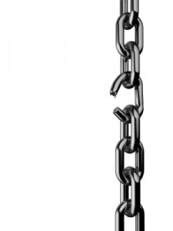
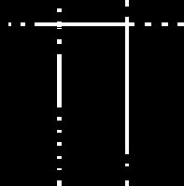
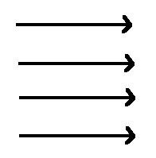
INITIAL INSIGHTS & INTUITION
THE LAST MOSQUITO TO BE COLLECTED IS THE ONLY ONE THAT COUNTS
THE PLAYING FIELD CAN BE DIVIDED INTO LOGICAL SECTIONS
ULTIMATELY, EVERY POINT ON THE BOARD NEEDS TO BE REACHED; SWEEPING ACCOMPLISHES THIS

Slide 5

THOUGHT 1: SWEEP EACH SECTION
THOUGHT 2: VISIT EACH SECTION INTELLIGENTLY
SWEEPING EACH SECTION LEADS TO LOTS OF OVERLAP
IDENTIFY MIDPOINTS, VISIT THEM IN ORDER
IDENTIFY SECTIONS
ASSIGN EACH SECTION A LIGHT
SWEEP ACROSS EACH SECTION
+

Slide 6
Click a picture, and then click the Format Picture tab to create your own frames and make picture corrections such as adjusting contrast and brightness or cropping the picture for just the right look.

Slide 7
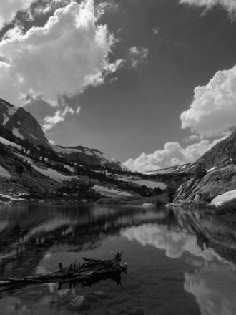
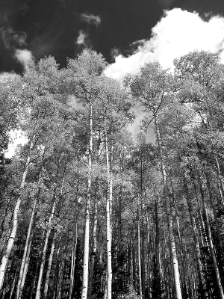
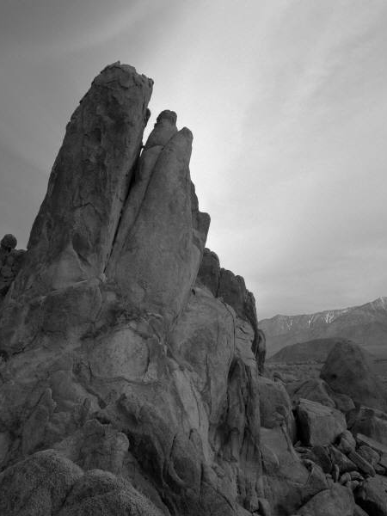
Picture Styles give you great looking “frames” in a single click.

Slide 8
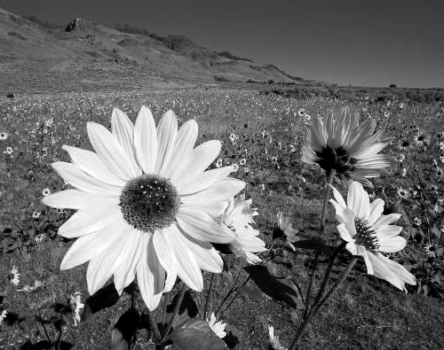
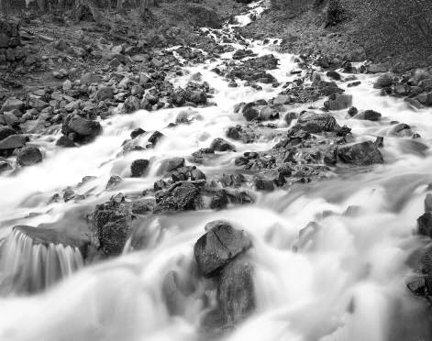

Slide 9
